Slide 1


Presentation Title: BOLT – THE VISION ASSISTANT
JEPPIAAR INSTITUTE OF TECHNOLOGY
“Self-Belief | Self Discipline | Self Respect”
Department of Computer Science and Engineering
Team Members:
Students Name Reg.No:
AKSHAY. J 210620104004
KAMALNATH. V 210620104025
KISHORE KUMAR. M.B 210620104030
Kirthick S.V 210620104026

Slide 2


JEPPIAAR INSTITUTE OF TECHNOLOGY
“Self-Belief | Self Discipline | Self Respect”
Department of Computer Science and Engineering
Bolt Vision Assistant

Slide 3
Abstract:
According to World Health Organization (WHO) report there are 285 million visually impaired people among which 39 million are totally blind.
The blind people cannot get information of their surrounding environment like obstacles and object
An Optical Character Recognition (OCR) system which is a branch of computer vision and a part of AI . OCR is the translation of optically scanned bitmaps of printed or handwritten text into audio output
Our project mainly works in the basis of ocr and has many voice assistant features too.
INTRODUCTION:
An assistant system is made our team which is powered by a raspberry pi
our portable version of this Bolt Vision assistant consist of having a wifi streaming camera and microphone which is attached to the glasses and a program trigger button which turns the AI on and of is located on a wrist band and a raspberry pi which can be in your pocket powered by a power bank
We also have more compact version with only a mobile phone which sends the image source to a computer server which does the calculations and sends back the output through internet

Slide 4
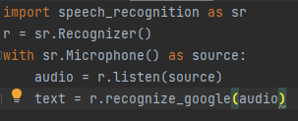
WORKING PRINCIPLE OF A VOICE ASSISTANT
Voice assistants simply work by getting user inputs in a audio format and convert it to text and searches the best match for the given input and produces output and then the output is converted to voice accordingly .
1. Getting inputs from the users :
Lets see how bolt gets inputs form the user :
bolt uses a speech recognition module which is made by google this allows us to get voice inputs with microphone as source and then it is converted to text
Usage :
this simple code can get audio input and convert it to text format.
where,
text – your input in text format

Slide 5
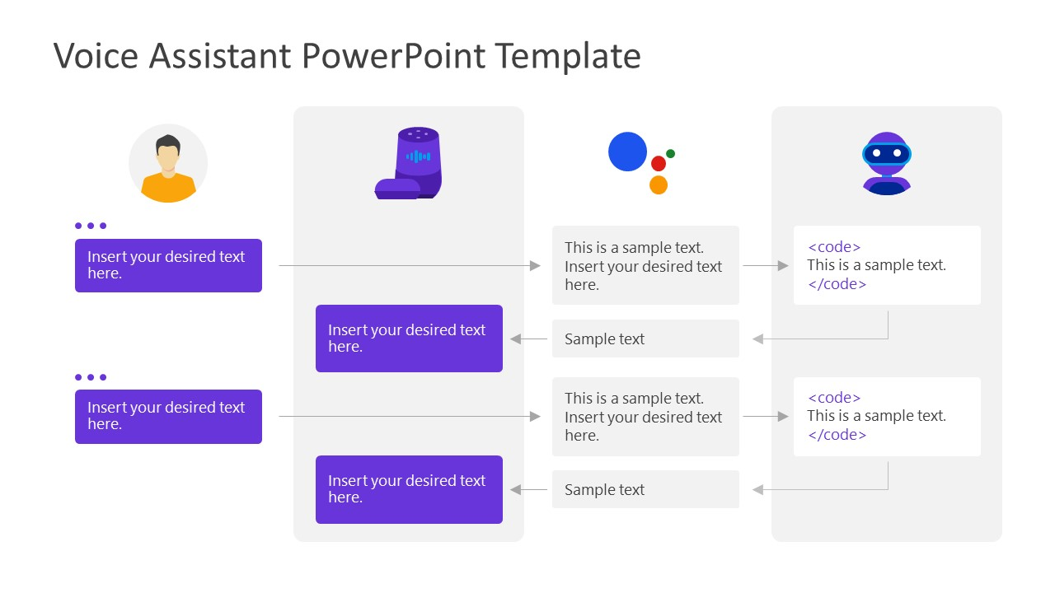
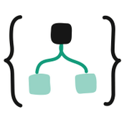

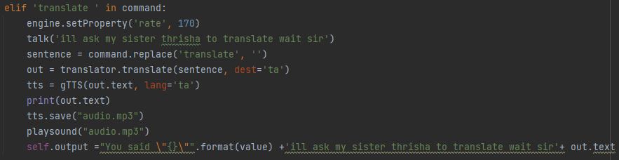
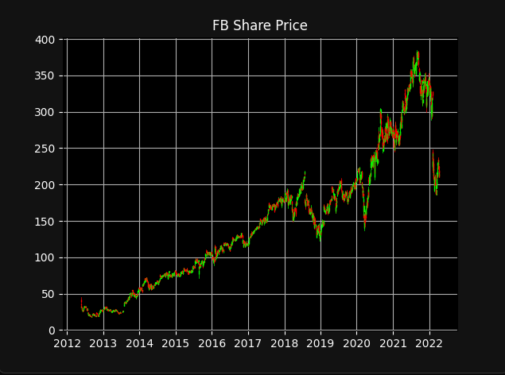
How does Bolt work
Searches for code block related to keyword translate
Bolt translate “hi how are you” in tamil.
Translating sir….
வணக்கம் எப்படி இருக்கிறாய்
Gets the desired output
Bolt show me the stocks of FB
Searches for code block related to keyword stocks
This is what I found sir
Gets the desired output

Slide 6
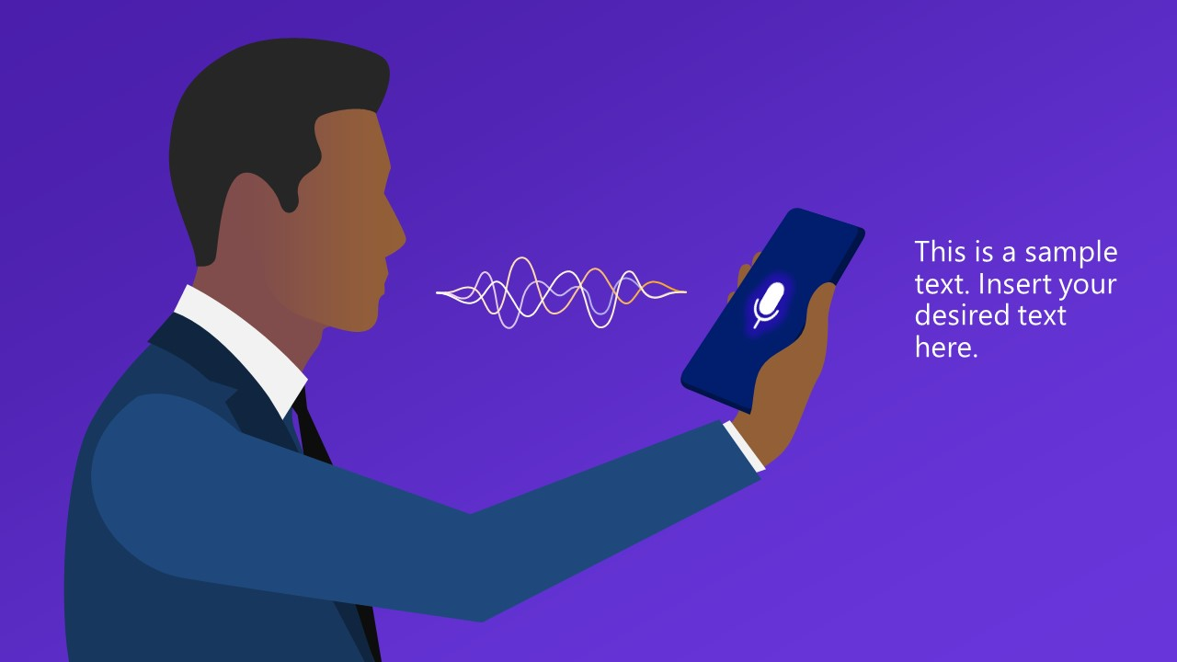

BOLT FEATURES
Bolt can do tasks like…
Playing songs (use ‘bolt play_your song’)
Translate from English to tamil(use ‘translate_your input’)
Take notes in handwriting format (use ‘take note’)
Visualise stock prices (use ‘show stocks’)
Translate from tamil to English(use ‘your input_in English’)
Send message in whatsapp (use ‘send message_your message’)
Ask time (use ‘tell time’)
Check Weather ‘weather_in_your_city_name’)
Ask about someone (use ‘who is_your query’)
Set Alarm (use ‘set alarm’)
List commands (use ‘what can you do’)
Introduce itself (use ‘who are you’)
Open or close apps (use ‘open’ or ‘close’ respectively)
Opening websites (use ‘goto_youtube,facebook….
Google something (use ‘google _your query’)
Predict stocks using ML(use ‘guess’ )
Ask geographical or calculating questions( use ‘geography’ and your query)
Get a advice (use ‘advice’ in command)
Open gmail (use ‘gmail’ in command)
Read texts ( use ‘read’ in command)
Run ocr (use ‘show’ in command)
For emergency (use ‘help’ in command)
To send handfree email (use ‘gmail’ in command )

Slide 7
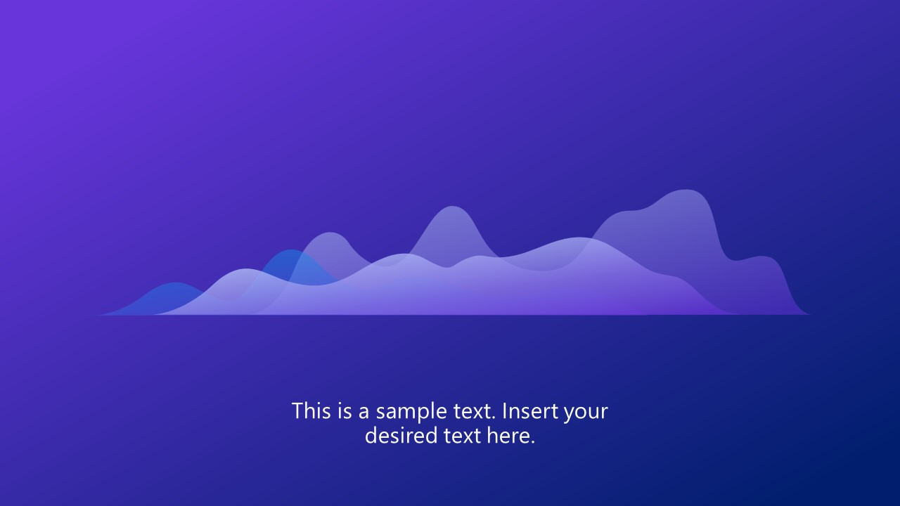
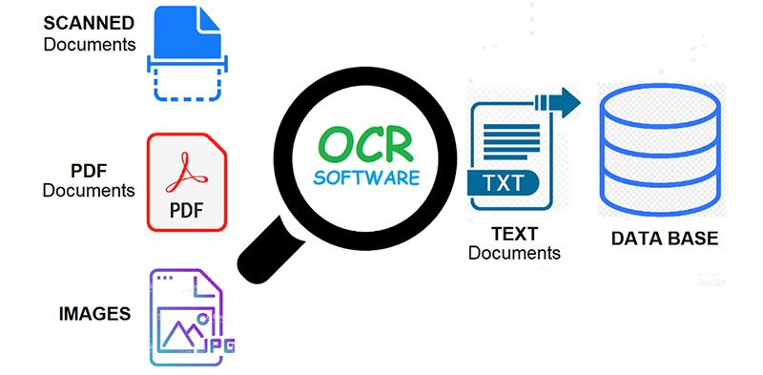
Special Features in Bolt - OCR
Feature:
since people who are blind cant read texts or signs or other things Our bolt also has unique feature called Object character recognition.
What is OCR:
Optical character recognition or optical character reader is the electronic or mechanical conversion of images of typed, handwritten or printed text into machine-encoded text, whether from a scanned document, a photo of a document, a scene-photo or from subtitle text superimposed on an image.
Tesseract:
Tesseract is an optical character recognition engine for various operating systems. It is free software, released under the Apache License.it works in the basis of deep learning
Working:
Our bolt gets input from open cv video input and it is converted to frames and each frames is scanned by tesseract engine and the output is obtained accordingly

Slide 8

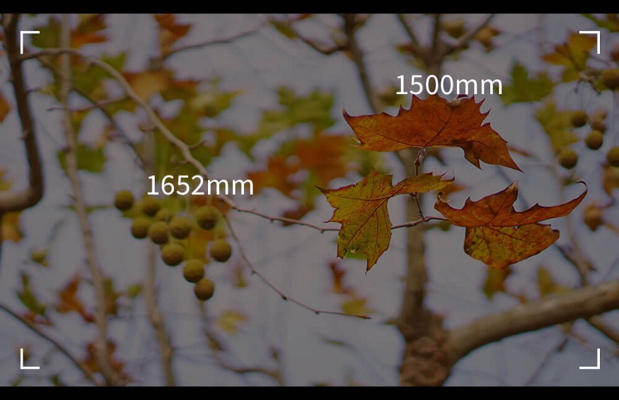
Special Features in Bolt- Tensorflow
Efficient Implementation of this Model depends upon the compatibility with python and library installation hurdles. This is the most complex part too. Thankful to STACKOVERFLOW and Python Unoffiicial Binary Releases for having pre-builded files uploaded and you can just download it from here as per your system’s compatibility.
We have implemented it by using TensorFlow APIs.The advantange ist, it provides us with a set of common operations. Because of which we don’t have to write the code for program from scratch .so these provides us convenience and hence they are time saver.
The TensorFlow object detection API is basically a structure build for creating a deep learning network that solves the problems for object detection.There are trained models in their framework and they refer it as Model Zoo .This includes a collection of COCO dataset, the KITTI dataset, and the Open Images Dataset. Here, we are primarily focused on COCO DATASETS
DEPTH ESTIMATION FROM IMAGE
Our prototype is used to assist the blind people which aims to issue warning to the blind people about the hurdles coming on their way,so , we need to find that at how much distance the obstacle and person are located in any real time situation. After the object is detected rectangular box is generated around that object.

Slide 9
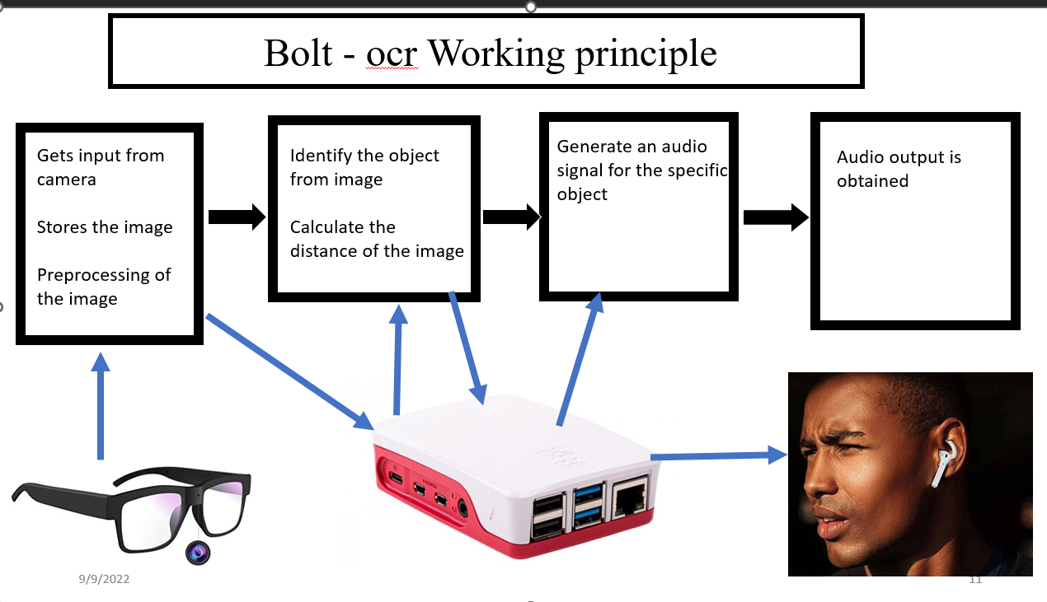

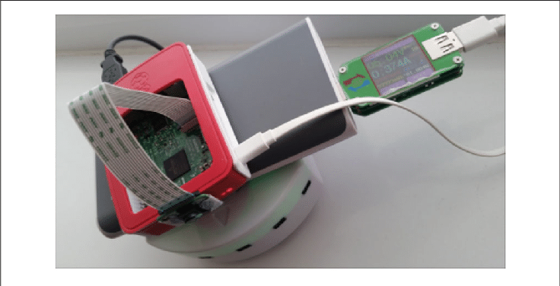
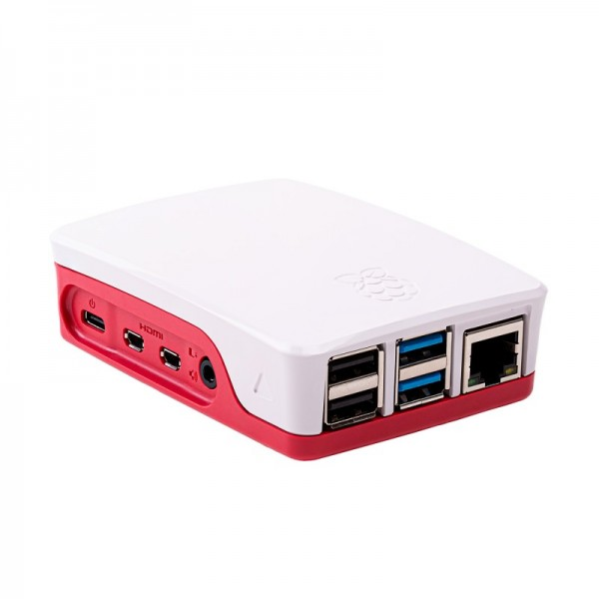
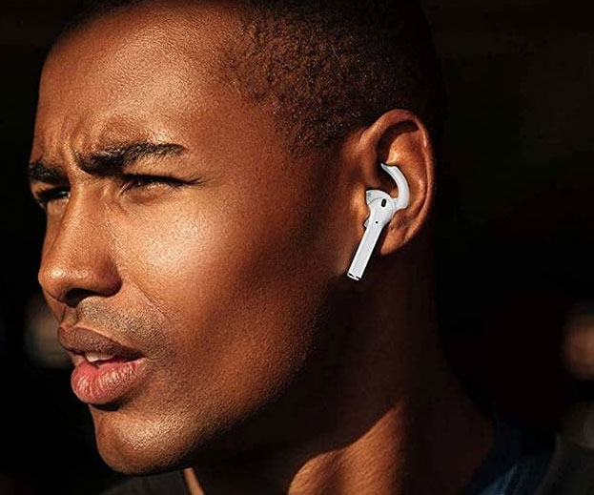
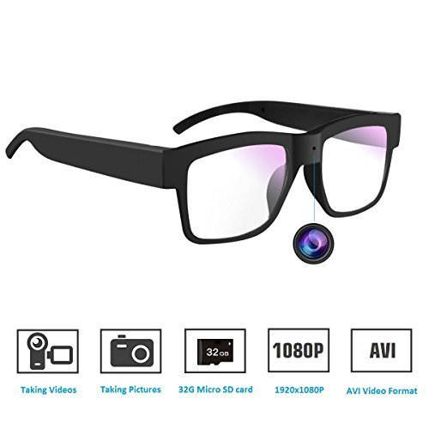
Special Features in Bolt
Bolt - ocr Working principle
Gets input from camera
Stores the image
Preprocessing of the image
Identify the object from image
Calculate the distance of the image
Generate an audio signal for the specific object
Audio output is obtained
Searches for code block related to keyword translate
Trigger button to turn bolt on and off,
And to intitiate a task from wrist
Raspberry pi with a powerbank and wifi module running our software passively in his pocket or a bag

Slide 10
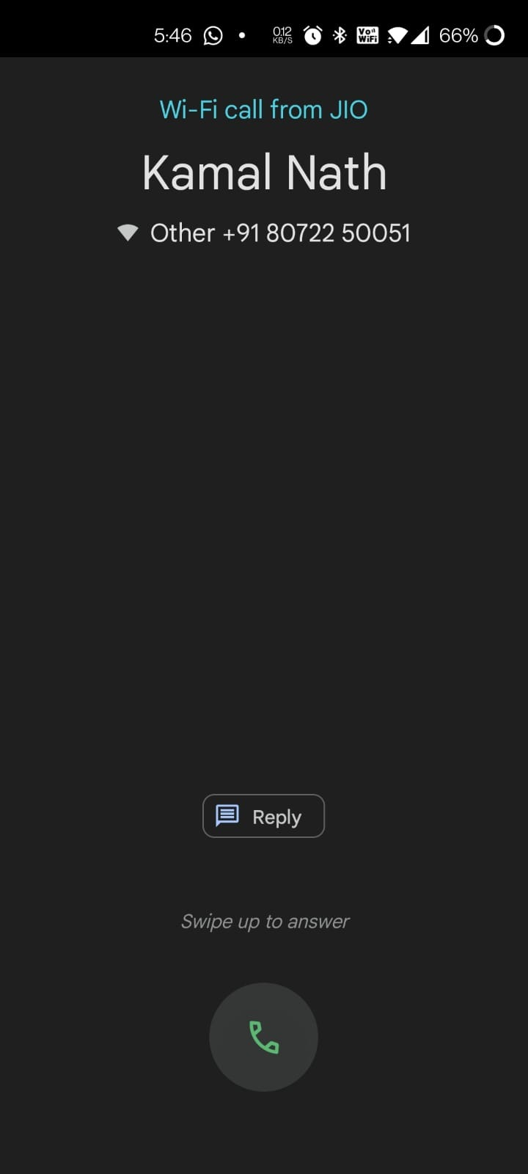
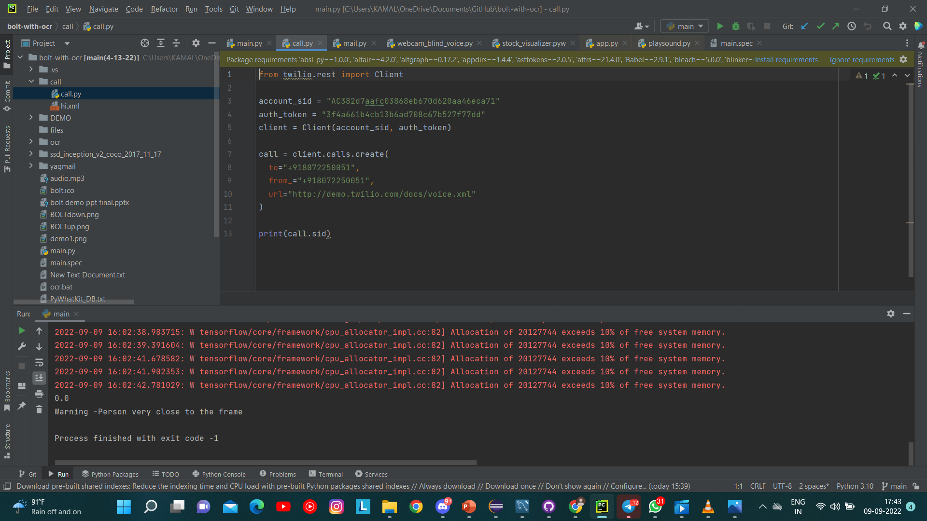

Emergency Situation
We use a api called twilio which allows us to call with a virtual number with predefined voicef so we can configure it to call to any number we want
Input :‘bolt help me’
Output : ‘Im calling your emergency number’
Automated email :
We again use a api called smtp which allows us to send email through python
Input :‘bolt open voice gmail’ -------------------------------------->Output : ‘please choose the recipient’
input: ‘recipient name’----------------------------------------------->Output : ‘what is the content of email’
input : ’your content’-------------------------------------------------> Output : ‘your mail is sent’

Slide 11
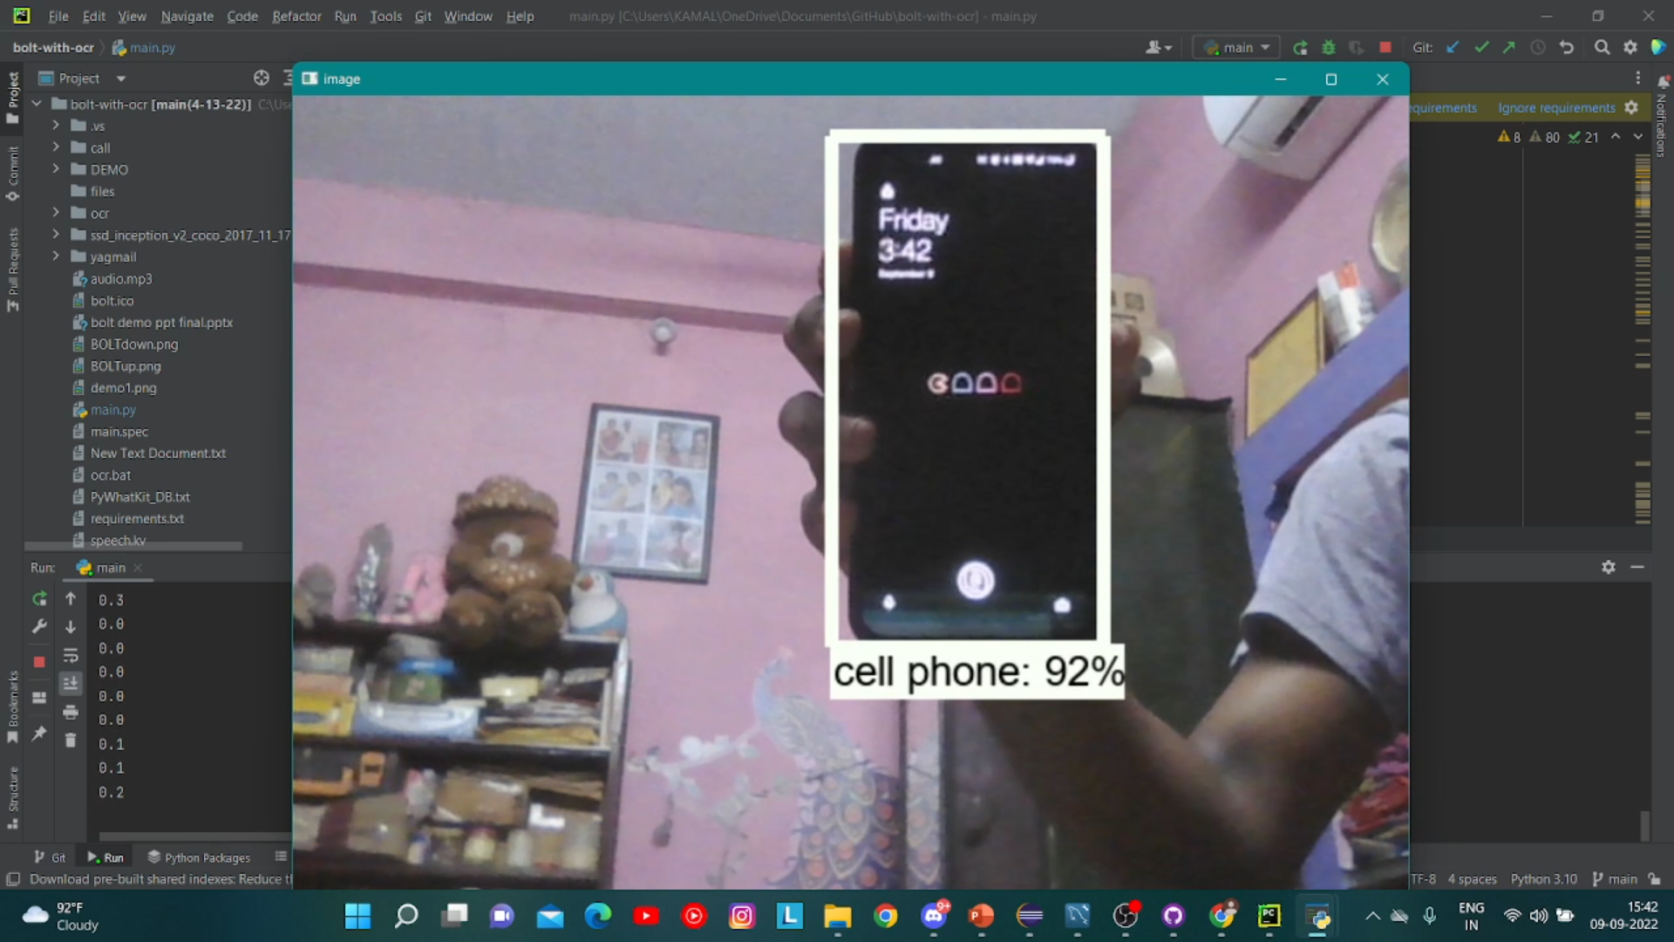
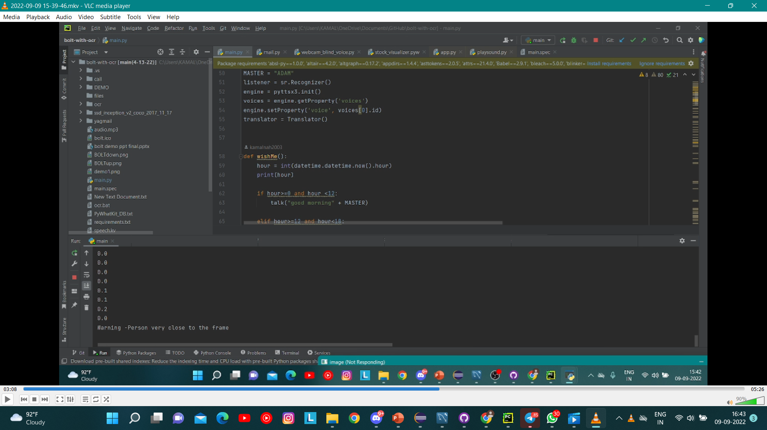



Output:
Press bolt icon
Tell ‘bolt show objects’
Output audio : Person very close to the frame

Slide 12
Summary
From this presentation we get to know that importance of vision assistant
We have seen its working principle
We have see how our Bolt – VA works and how it was made
how the image is being processed and how it gets output
We have also seen what is tensorflow module and coco datasets.
We have also seen How we can implement in real life

Slide 13
Thank you

